Slide 1


Telco
Customer Churn
23 MAR 2024

Slide 2

Agenda
01
06
Introduction
Marketing Campaign
02
07
Executive Summary
Digital Presence
03
08
Market Overview
Sales Funnel Analysis
04
09
Customer Demography
Analysis Feature
05
10
Sales Performance
Revenue Growth

Slide 3
Welcome to our Sales Report Presentation. Today, we delve into a comprehensive overview of our sales performance, exploring the highs, challenges, and strategic insights that have shaped our journey. This presentation is more than just numbers, it's a narrative of our collective efforts, showcasing the impact of our sales strategies and the pathways to future success.
Introduction

Slide 4

Executive Summary
This executive summary provides a concise snapshot of our sales performance. Highlighting key achievements and acknowledging challenges, we'll delve into the details of our journey. The report offers insights into the factors shaping our sales outcomes and outlines strategic initiatives for future success. Join us as we navigate through the highlights and challenges, setting the stage for an insightful discussion on our sales landscape.

Slide 5

Market Overview
Before delving into our sales performance, let's glance at the broader market context. The market is dynamic, with notable trends and key competitors. Understanding these dynamics will provide valuable insights into our sales landscape and strategies. Let's explore how external factors shape our narrative and identify opportunities for success.

Slide 6




Code of Conduct
Our customers are mostly young adults, with a significant portion falling within the 20-35 age range.
Geographic Distribution
Our customers are spread globally, showcasing our effectiveness in diverse markets.
Customer Demography
Industry Segmentation
Our customers come from a variety of industries, with a notable presence in fashion, showcasing our versatile offerings.
Buying Preferences
Our customers prefer online purchases, highlighting the significance of our online platform.

Slide 7

Sales Performance
Revenue Growth
Our sales efforts have yielded a commendable 65% increase in revenue compared to the previous period, showcasing robust growth in product/service sales.
Customer Retention
Our focus on customer satisfaction and relationship-building is evident in a 55% increase in customer retention, underlining our commitment to long-term partnerships and loyalty.
Market Penetration
Successful market penetration has been achieved in some specific market segments, demonstrating our ability to capture new opportunities and expand our customer base.

Slide 8

Marketing Campaign
Target Audience Refinement
Our campaign strategy prioritizes a more refined understanding of our target audience. We aim to ensure a more personalized and impactful approach by leveraging data analytics and customer insights.
Multichannel Engagement
To maximize reach, our campaigns will span across various channels, including social media, email marketing, and targeted online advertising.
Influencer Collaborations
Partnering with influencers who align with our brand values will be a key element of our strategy. Their authentic endorsements can significantly impact audience perception.

Slide 9

Digital Presence
Optimized Website
Our website has undergone enhancements to ensure a seamless and user-friendly experience, providing valuable information to visitors.
Social Media Engagement
Active across various platforms, our social media presence fosters real-time engagement and community building through regular updates and responsive communication.

Slide 10




Sales Funnel Analysis
Conversion Rates
Customer Acquisition Cost (CAC)
Retention and Upsell
Lead Generation
Evaluate the efficiency of lead generation strategies to attract potential customers. Identify areas for improvement.
Break down the sales funnel stages and assess conversion rates. Target areas for improvement to enhance overall funnel efficiency.
Calculate the cost of acquiring a new customer at each stage. Optimize resource allocation for cost-effective customer acquisition.
Analyze post-purchase stages to enhance customer retention and identify upsell opportunities.

Slide 11
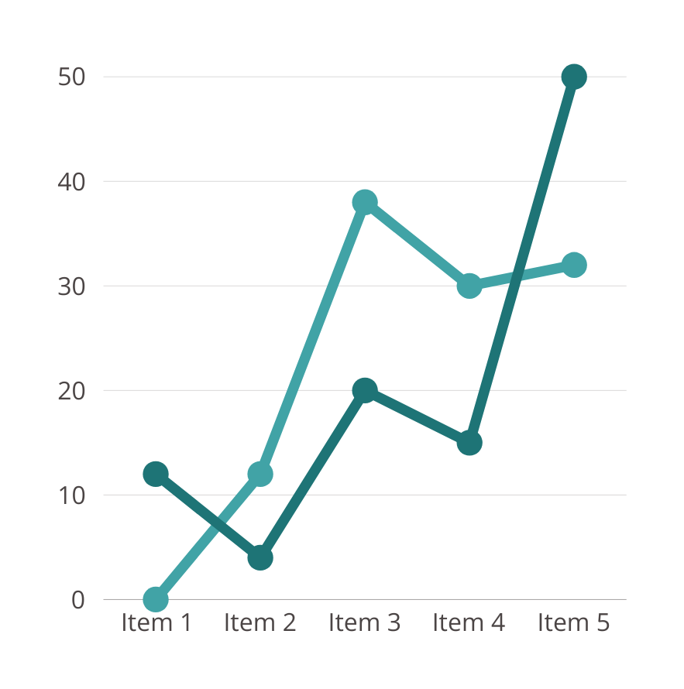

Analysis Feature
Customer Segmentation Insights
Dive into customer segmentation to identify distinct buyer personas and understand their unique preferences and behaviors. This analysis will provide valuable insights for targeted marketing efforts, allowing us to tailor strategies to specific customer segments and enhance overall engagement and conversion rates.

Slide 12

Revenue Growth
The sales report reveals a notable 65% surge in overall revenue, signaling the success of our sales strategies and the market reception of our products. Our analysis encompasses a breakdown by product, examines the impact of market expansion, and explores the interplay between customer acquisition and retention.
We also assess the effectiveness of various sales channels. This comprehensive overview not only celebrates our current achievements but also informs strategic decisions for continued and diversified revenue growth in the future.

Slide 13




Customer Review
Morgan Maxwell
Richard Sanchez
Alfredo Torres
Chad Gibbons
I purchased this product a month ago, and it's been my favorite! The quality is outstanding, and it exceeded my expectations.
I can't say enough good things about this great product. It's hands down the best purchase I've made.
Not only is the product fantastic, but the customer service is also outstanding. I had a minor issue, and the support team was quick to respond and resolve it.
This product delivers on its promises. The performance is impressive, and it has significantly enhanced my activity.

Slide 14


Marketing Team Performance
The marketing team has excelled in driving impactful initiatives during the reporting period. Their strategic lead generation efforts resulted in a notable increase in qualified leads, while a multi-channel approach enhanced brand visibility and customer engagement.
Swift adaptability and data-driven decision-making optimized campaigns, contributing significantly to our impressive revenue growth. The team's commitment to aligning marketing efforts with sales goals has been a key factor in our overall success. Looking ahead, we aim to build on this momentum for continued achievements.

Slide 15
Thank You
23 MAR 2024

